Slide 1
Introduction
to Python
Seraphina | Xue Qi

Slide 2
Hello! We are NYP LIT
NYP Ladies in Tech is the newest of the four special interest groups
Our mission is to empower women of our generation

Slide 3
Table of Content
Variables, Expressions, and Statements
Creating Flowcharts
1
6
Operators
Conditional Statements (if, else, elif)
2
7
Data Types
Loops (while loops, for loops)
3
8
Input and Output
Lists, Dictionaries, and Tuples
4
9
Errors in Python
Functions and Modules
5
10

Slide 4
Part 1

Slide 5
Variables, Expressions, and Statements
What are variables?
Placeholders for pieces of information that can change
Store data and allow the program to retrieve the data using the variable name
Rules for naming variables
Start with a letter or underscore
Consists of letter, number, or underscore
Case sensitive
Cannot be a reserved word (e.g. False, None, return, if)

Slide 6
Variables, Expressions, and Statements
What are expressions?
A combination of variables and operators, with or without literals, that evaluates to a value
Literals
Data or raw value that is specified in a variable
Basic literal types:
Numeric
String (enclosed in either single, double, or triple quotes)
Boolean (True and False)

Slide 7
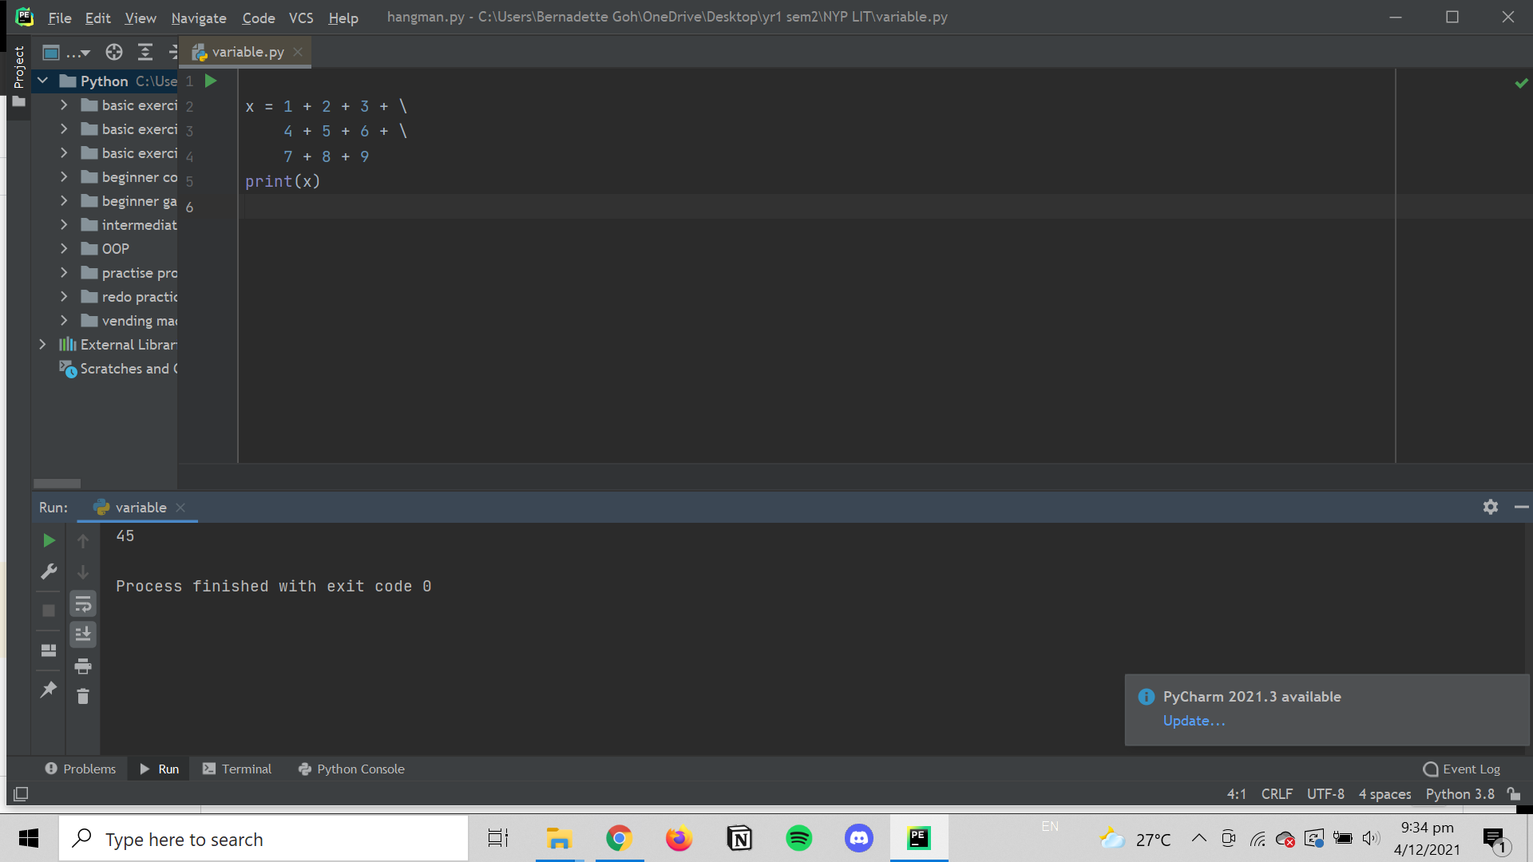
Variables, Expressions, and Statements
What are statements?
An instruction that the Python interpreter can execute
Examples:
Assignment statement
If statement
For statement
While statement
Multi-line statement

Slide 8
Operators - arithmetic operators
Name | Operator | Example
Addition | + | x + y
Subtraction | - | x - y
Multiplication | * | x * y
Division | / | x / y
Floor division | // | x // y
Exponentiation | ** | x ** y
Modulo | % | x % y

Slide 9
Operators - assignment operators
Operator | Example | Same As
= | x = 5 | x = 5
+= | x += 5 | x = x + 3
-= | x -= 5 | x = x - 3
*= | x *= 5 | x = x * 3
/= | x /= 5 | x = x / 3
%= | x %= 5 | x = x % 3
//= | x //= 5 | x = x // 3
**= | x **= 5 | x = x ** 3

Slide 10
Operators - comparison operators
Operator | Name | Example
Equal to | == | x == y
Not equal to | != | x != y
Greater than | > | x > y
Less than | < | x < y
Greater than or equal to | >= | x >= y
Less than or equal to | <= | x <= y

Slide 11
Operators - logical operators
Operator | Description | Example
and | Returns true if both statements are true | x < 5 and x < 10
or | Returns true if one of the statements is true | x < 5 or x < 4
not | Reverses the result of the condition in the brackets | not (x < 5 and x < 10)

Slide 12
Data Types
The 4 basic data types
Integers (int)
Float (float)
String (str)
Boolean (bool)
type() can be used to check on the type of data
Type conversion function can be used to change the data type of a variable
sum = int(“2”) + 5
Data types can be mixed in expressions and statements, but there are some rules

Slide 13
Data Types
Rules to mixing data types
Operations between integer and floating point number yields floating point number
1 + 3.5 = 4.5
When booleans are used in arithmetic operations, true is 1 and false is 0
A string multiplied with an integer returns a repeated string value
5 * “g” = “ggggg”
Division of two numbers result in a floating point number
A number and a string cannot be added together
A float and a string cannot be added together
A boolean and a string cannot be added together

Slide 14
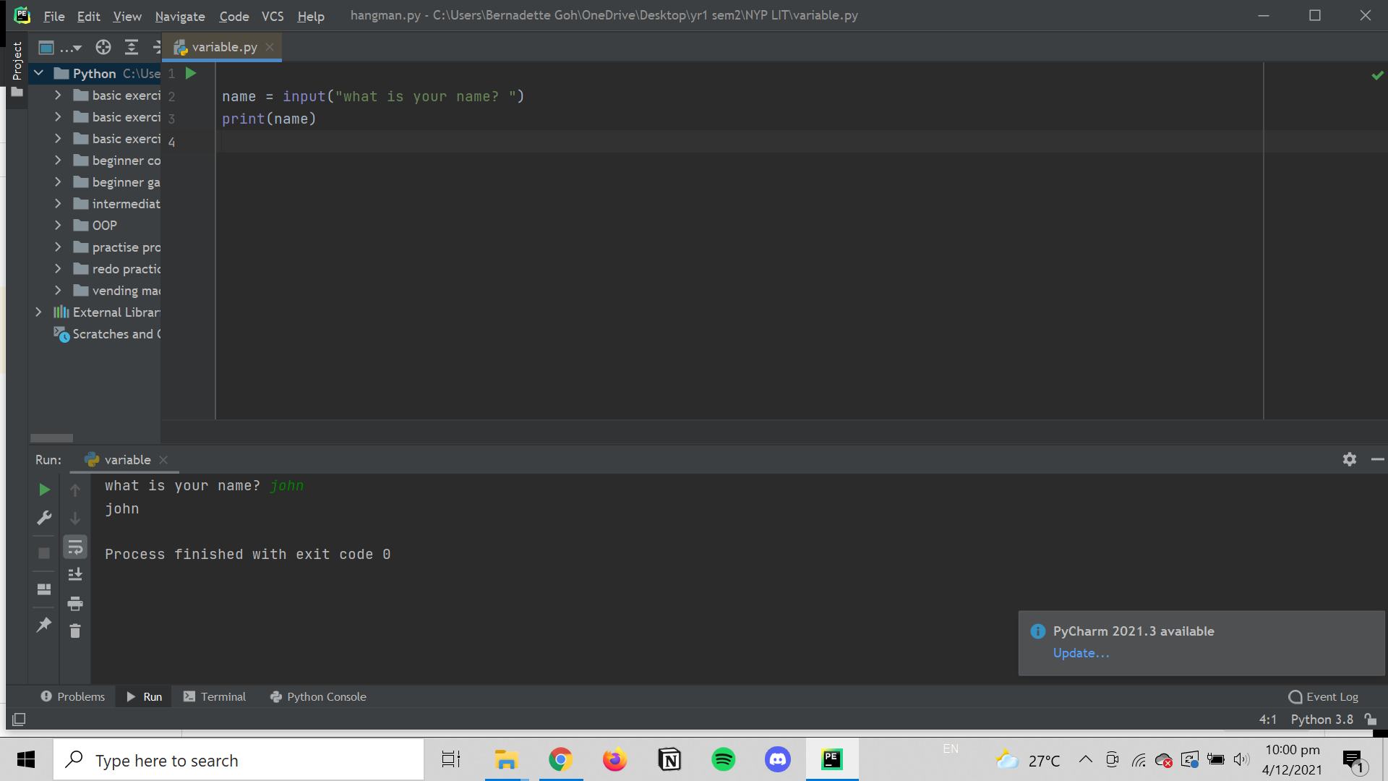
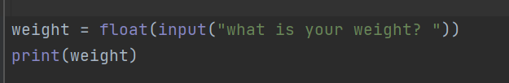
Input and Output
Input
The input() function allows the program to read from the keyboard
When it is called, program flow stops until the user has given an input and ends it by pressing the enter key
input() function will always return the user’s input as a string

Slide 15
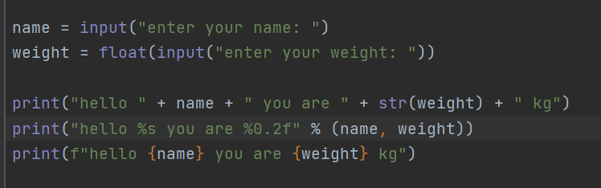
Input and Output
Output
The print() function takes in any number
of parameters, and prints them out on one line of text
Three common ways to format output:
String concatenating operator (+)
String modulo operator (%)
String method “format” (f)

Slide 16
Errors in Python
What are errors?
Errors or mistakes in a python program are often referred to as bugs
The process of finding and eliminating these errors is called debugging
Errors in python can be classified into three main categories: syntax, runtime and logical
Syntax errors are mistakes in the use of python language and are similar to spelling or grammar mistakes
Runtime errors occurs when the program exists unexpectedly during the execution of a program because it runs into an error
Logical errors occurs when the program runs without crashing but produces an incorrect result due to an error in the program’s logic

Slide 17
Errors in Python
Syntax errors
Misusing the assignment operator
Misspelling or missing python keywords
Missing parentheses, brackets, and quotes
Missing dictionary syntax
Using the wrong indentation
Incorrect definitions and calling of functions
Runtime errors
Division by zero
Performing an operation on incompatible types
Using an identifier which has not been identified
Accessing a list element, dictionary value, or object attribute that does not exist
Trying to access a file that does not exist

Slide 18
Errors in Python
Logical errors
Using the wrong variable name
Indenting a block to the wrong level
Using integer division instead of floating point division
Getting the operator precedence wrong
Making a mistake in a boolean expression
Off by one, and other numerical errors

Slide 19
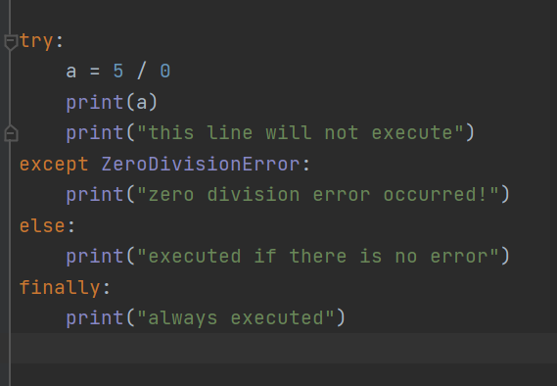
Errors in Python
Error handling with try-except block
Try block contains the code to be monitored for the exceptions
Except block contains what is to be done if a specific exception occurs
Else block is executed only if no exceptions occur in the try block
Finally block is used for clean up code and is always executed
Else and finally blocks are optional

Slide 20
Creating Flowcharts
Start
What is a flowchart?
A graphical representation of the program steps
Contains different types of symbols to represent different types of operations
The symbols are connected by arrows that represent the flow of the program
Do something
Yes/No?
No
Yes
Output something
End

Slide 21
Let’s start coding!

Slide 22
Part 2

Slide 23
Conditional Statements - if, elif, else
if statement
Used when we want to execute a code block only if a given test condition is True
elif statement
Used when we want to check for multiple conditions
If the first ELIF condition is false, the next ELIF test condition is checked (this is
repeated until the last ELIF condition)
else statement
Executed when IF and ELIF statements above it are all False
nested if statement
An IF statement placed inside another IF statement
Used when you what to test conditions inside a condition

Slide 24
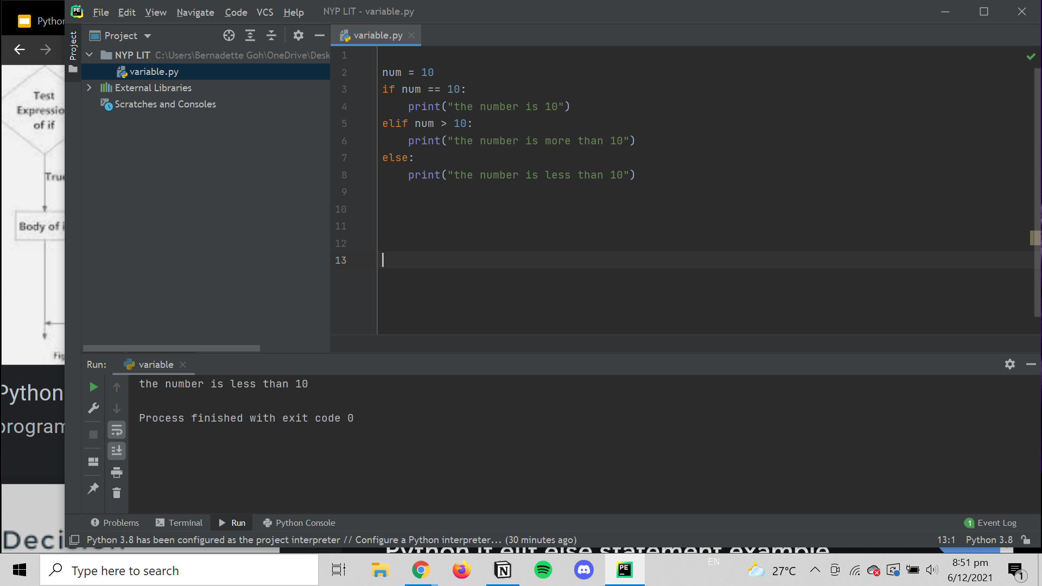
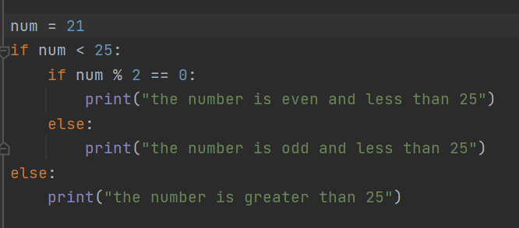
Conditional Statements - if, elif, else
Example
if statement
Nested if statement
>>>the number is 10
>>>the number is odd and less than 25

Slide 25
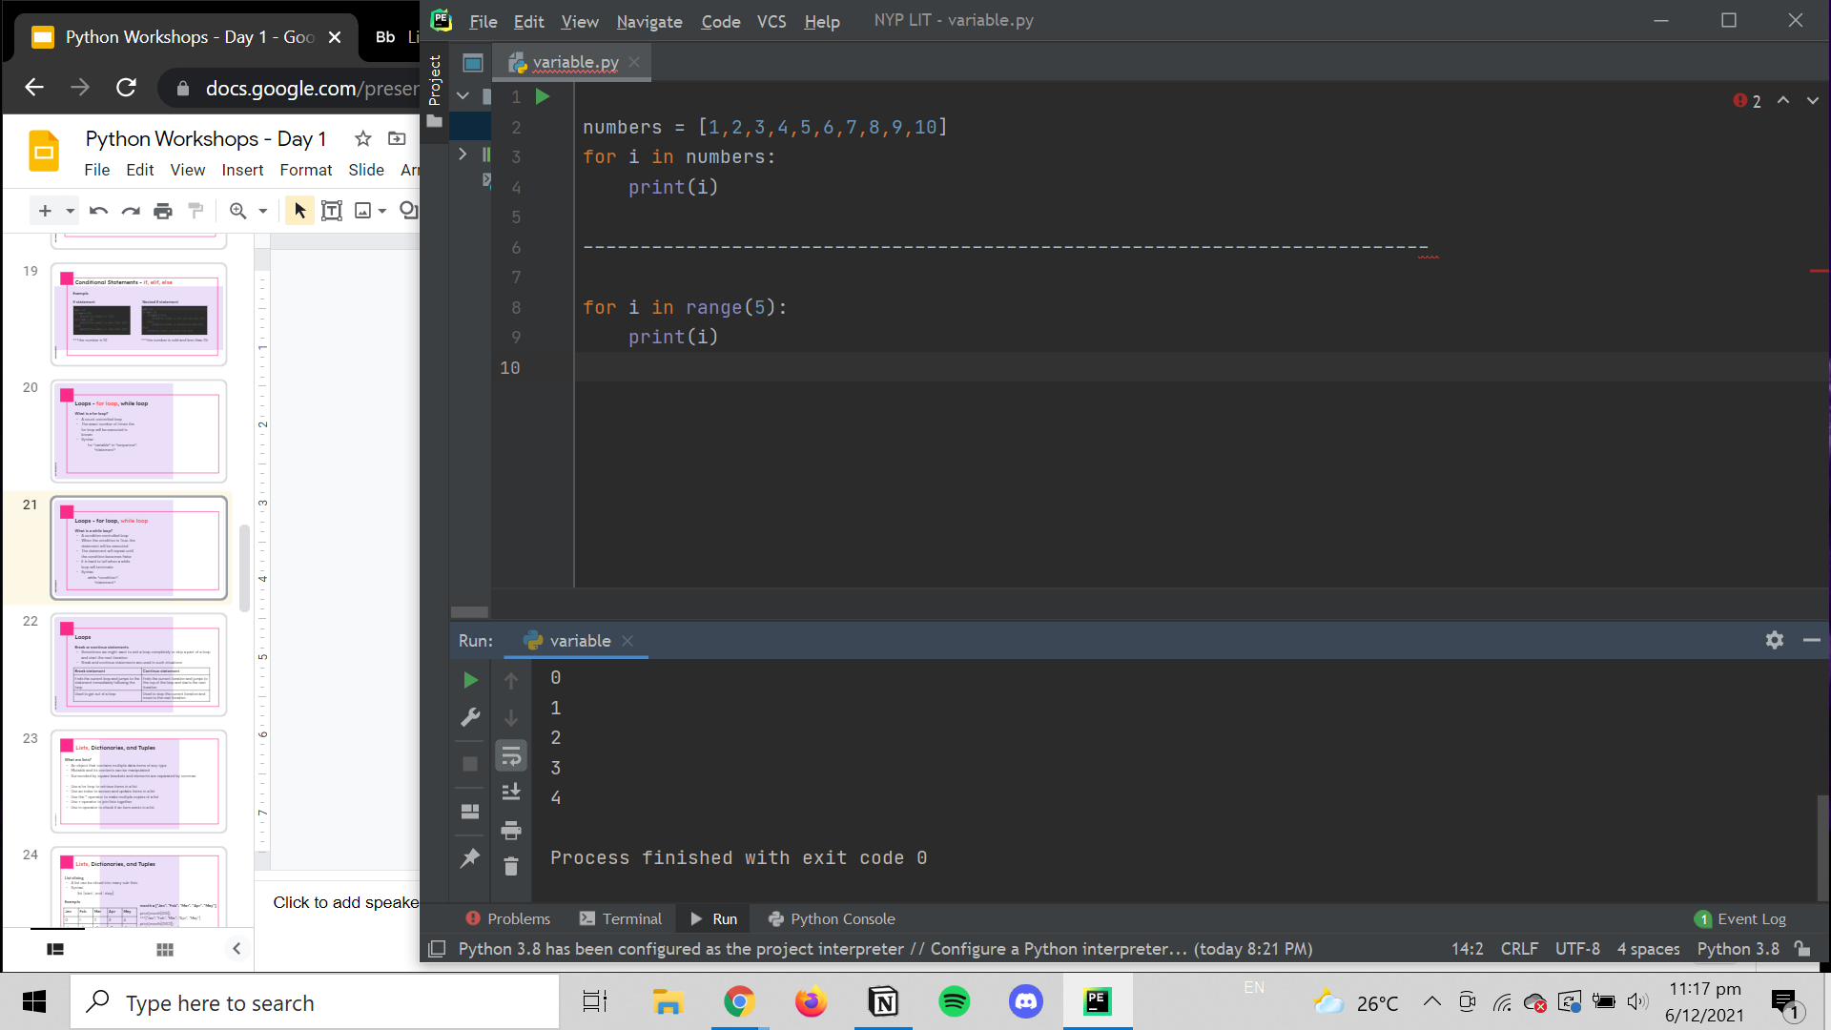
Loops - for loop, while loop
What is a for loop?
A count controlled loop
The exact number of times the for loop will be executed is known
Syntax:
for <variable> in <sequence>:
<statement>

Slide 26
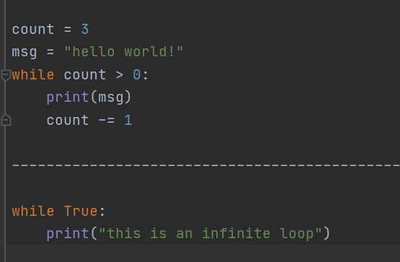
Loops - for loop, while loop
What is a while loop?
A condition controlled loop
When the condition is True, the statement will be executed
The statement will repeat until the condition becomes False
It is hard to tell when a while loop will terminate
Syntax:
while <condition>:
<statement>

Slide 27
Loops
Break or continue statements
Sometimes we might want to exit a loop completely or skip a part of a loop and start the next iteration
Break and continue statements are used in such situations
Break statement | Continue statement
Ends the current loop and jumps to the statement immediately following the loop | Ends the current iteration and jumps to the top of the loop and starts the next iteration
Used to get out of a loop | Used to stop the current iteration and move to the next iteration

Slide 28
Lists, Dictionaries, and Tuples
What are lists?
An object that contains multiple data items of any type
Mutable and its contents can be manipulated
Surrounded by square brackets and elements are separated by commas
Use a for loop to retrieve items in a list
Use an index to access and update items in a list
Use the * operator to make multiple copies of a list
Use + operator to join lists together
Use in operator to check if an item exists in a list

Slide 29
Lists, Dictionaries, and Tuples
List slicing
A list can be sliced into many sub-lists
Syntax:
list [start : end : step]
Example
month = [“Jan”, “Feb”, “Mar”, “Apr”, “May”]
print(month[0:6])
>>>[“Jan”, “Feb”, “Mar”, “Apr”, “May”]
print(month[0:6:2])
>>>[“Jan”, “Mar”, “May”]
Jan | Feb | Mar | Apr | May
0 | 1 | 2 | 3 | 4
-5 | -4 | -3 | -2 | -1

Slide 30
Lists, Dictionaries, and Tuples
What are dictionaries?
An object that stores a collection of data
Each element in the dictionary has two parts: a key and a value
Mutable, but their contents indexed by keys are immutable
Surrounded by curly braces and key value pairs are separated by commas
Use del() function to delete an element in the dictionary
Use dict[key] to retrieve the value of an element from the dictionary
Use dict[key] = value to update a value (if the key does not exist, a new element
will be added)
Use in operator to check if an element with the key exists in the dictionary
Use a for loop to display all elements in the dictionary

Slide 31
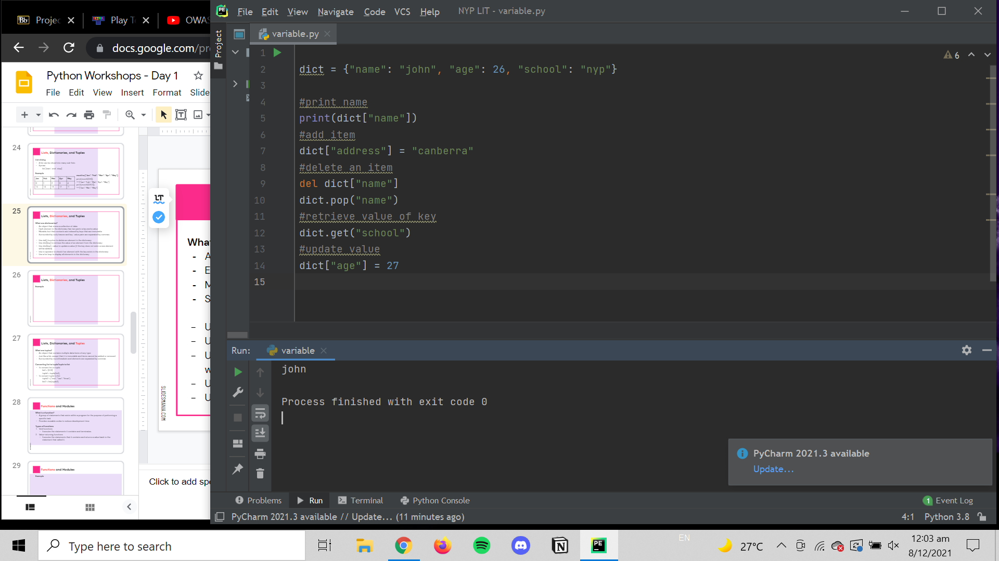
Lists, Dictionaries, and Tuples
Example

Slide 32
Lists, Dictionaries, and Tuples
What are tuples?
An object that contains multiple data items of any type
Just like a list, except that it is immutable and items cannot be added or removed
Surrounded by round brackets and elements are separated by commas
Converting list to tuple/tuple to list
To convert list to tuple:
list1 = [1,2,3]
tuple1 = tuple(list1)
To convert tuple to list:
tuple2 = (“one”, “two”, “three”)
list2 = list(tuple2)

Slide 33
Functions and Modules
What is a function?
A group of statements that exists within a program for the purpose of performing a specific task
Provides reusable codes to reduce development time
Types of functions
Void functions
Executes the statements it contains and terminates.
Value-returning functions
Executes the statements that it contains and returns a value back to the statement that called it.

Slide 34
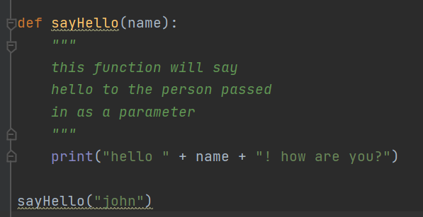
Functions and Modules
Components of functions
def keyword to mark the start of the function
A name to uniquely identify the function
Parameters/arguments that are passed into the function (optional)
Colon to mark the end of the function header
Docstring to describe what the function does
Valid python statements to make up the function body
Return statement to return a value to the function (optional)

Slide 35
Functions and Modules
What is a module?
A Python file that can be imported inside another Python program
It can define functions, classes, and variables
Python has a from statement that allows the import of all names from a module into the namespace
Syntax:
from <module name> import */<function name>
Advantages
Maintainability
Reusability

Slide 36
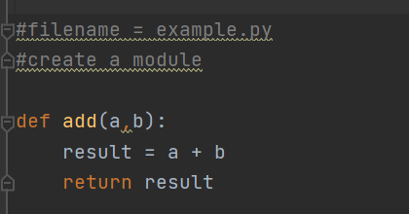
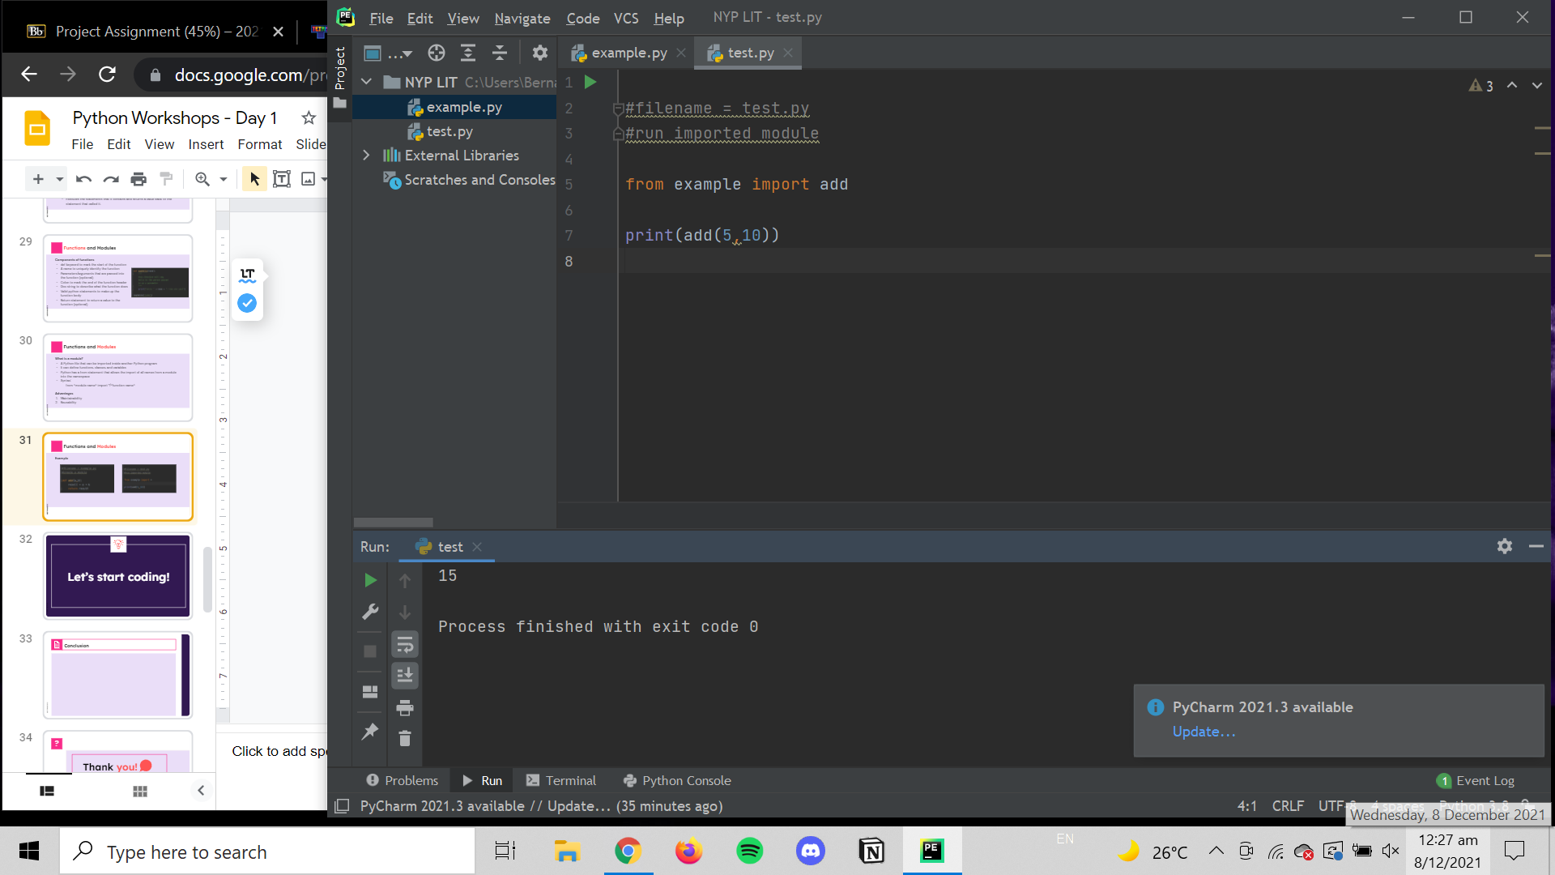
Functions and Modules
Example

Slide 37
Let’s start coding!

Slide 38
Conclusion
We have covered the following:
Using of variables, expressions and statements in a program
Using of arithmetic and comparison operators
The 4 basic data types
Using input and output functions
Identification and debugging of errors in a program
Creation of flowcharts
Application and structure of conditional statements in a program
Application of loop control structures in a program
The 3 kinds of sequential data types
Using of functions and modules in a program

Slide 39
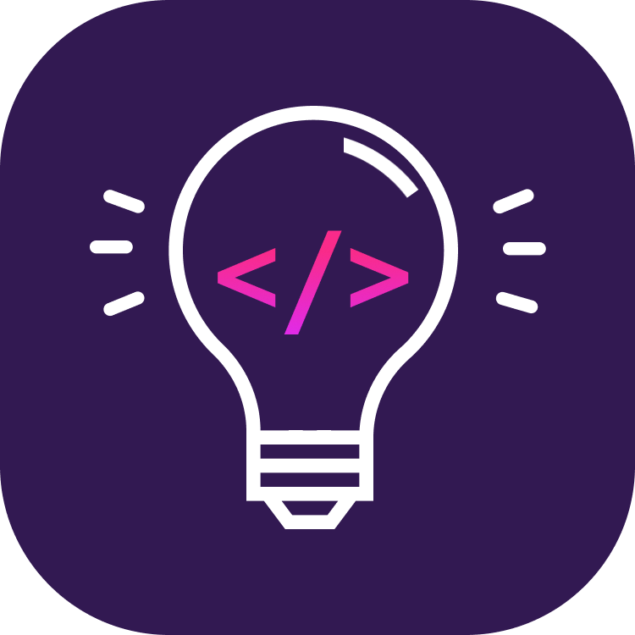
Thank you!
?
Do you have any questions?
Check out our socials or contact us at nyplit@gmail.com
@nyp_lit
https://nyp-lit.github.io/

Slide 40
Credits.
Presentation Template: SlidesMania
Images: Unsplash
Fonts used in this presentation: DM Sans and Lexend Deca

Slide 41
Editable Icons

